Slide 1
Recitation 1: User Stories
January 16, 2018

Slide 2
Welcome!
My name: Afsoon Afzal
Email address: afsoona@cs.cmu.edu
Office hour: Thursday from 1 to 3
Location: WEH 4113

Slide 3
User Stories

Slide 4
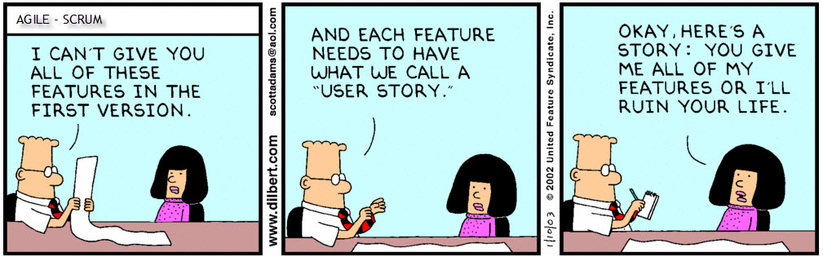

Slide 5
User Stories
Capture a description of a software feature from an end-user perspective
Are used for planning
Facilitate conversation among users, stakeholders, developers and etc.

Slide 6

Template
As a (type of user),
I want (some feature),
so that (some benefit)

Slide 7
Example
Imagine a job portal that connect employers to people looking for jobs
As a job seeker,
I want to upload my resume, so that employers consider me for jobs

Slide 8
Epics vs. User Stories
Epics are very high-level and can be divided into smaller user stories
As a user, I want to sort available jobs by their relevance to my field…
Epic:
Browse jobs
As a user, I want to search for jobs by keywords

Slide 9
Let’s try it
Imagine you have an idea of a banking application

Slide 10

Let’s try it

Slide 11
Let’s try it
Groups of 3-4 people
Brainstorm and write 5-10 user stories

Slide 12
What makes a good user story
ndependent
I
N
V
E
S
T
egotiable
aluable
stimatable
mall
estable

Slide 13
Rewrite your user stories
Take a look at your user stories and see if they’re consistent with INVEST model
Try to rewrite the inconsistent ones

Slide 14
What makes a good user story
ndependent
I
N
V
E
S
T
egotiable
aluable
stimatable
mall
estable

Slide 15
3 Cs approach
Card: The user stories written on cards by customer/product owner
Conversation: The communication between customer/product owner and developers
Confirmation: Acceptance criteria/test
Notes:
We want to encourage teams to have conversations long before they start working on a story – during backlog refinement and sprint planning. They should be having conversations while they’re working on the story – here’s what I have so far; is this correct? Am I on the right path? And they should be having conversations when they’re done with the story – here’s what I completed; is this correct? Do you accept the work?
The conversation is largely verbal, but can be supplemented with documents. The best supplements are examples; the best examples are executable, We call these examples confirmation.
how did the team know they were done with the story? What should the software do when we were done?

Slide 16
HW 1
Write high-quality user stories using 3 Cs approach

